Slide 1
ROBOT DESIGN JUDGING
Seshan brothers

Slide 2
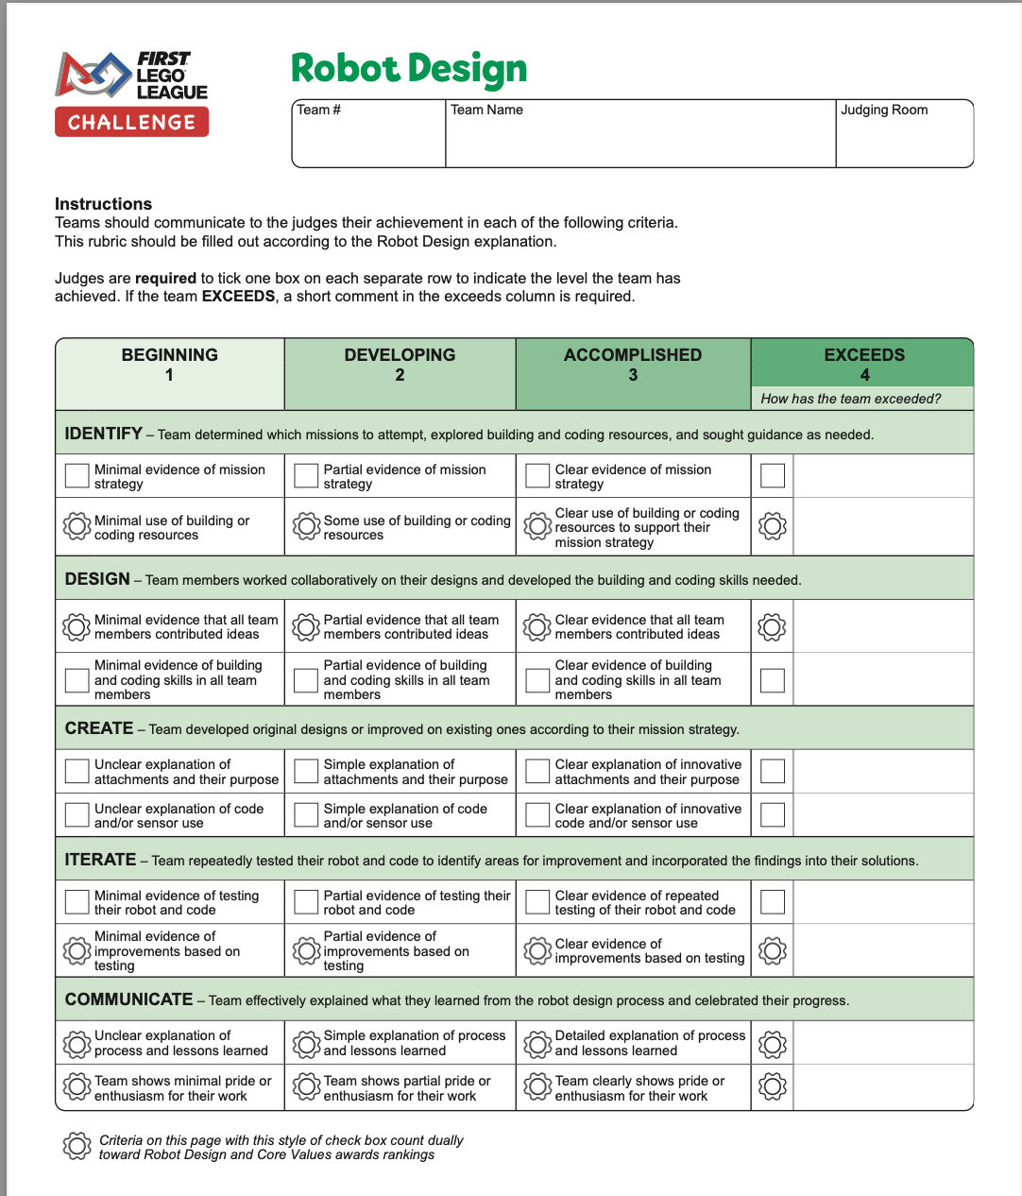
ROBOT DESIGN JUDGING OVERVIEW
Robot Design judging focuses on process
Talk to the judges about your engineering design process, and how you came up with your ideas and how you improved them
Make sure that everyone on the team is involved
During your 5-minute presentation, you need to cover all the components of the Robot Design rubric

Slide 3
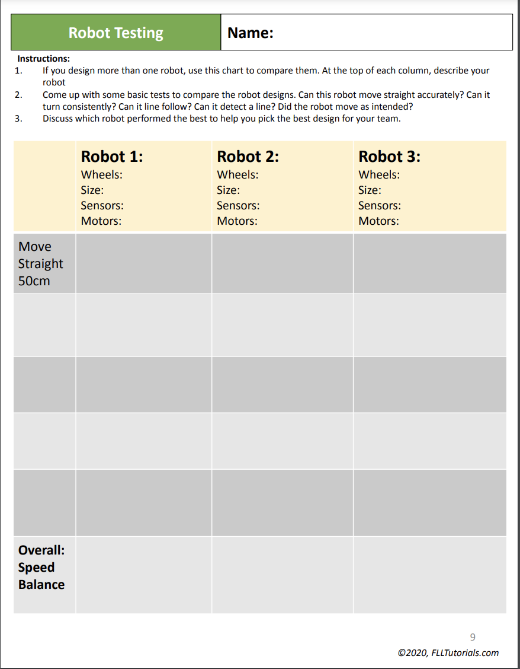
DESCRIBE YOUR ROBOT
How did you come up with the design for the base robot? Did you start with an existing design (your last year’s robot or something from the Internet/book)?
Experienced judges can recognize standard designs. Therefore, always cite your sources.
Did you test your design(s) before picking it?
What features does it have and why?
Available at https://flltutorials.com/en/Worksheets.html

Slide 4
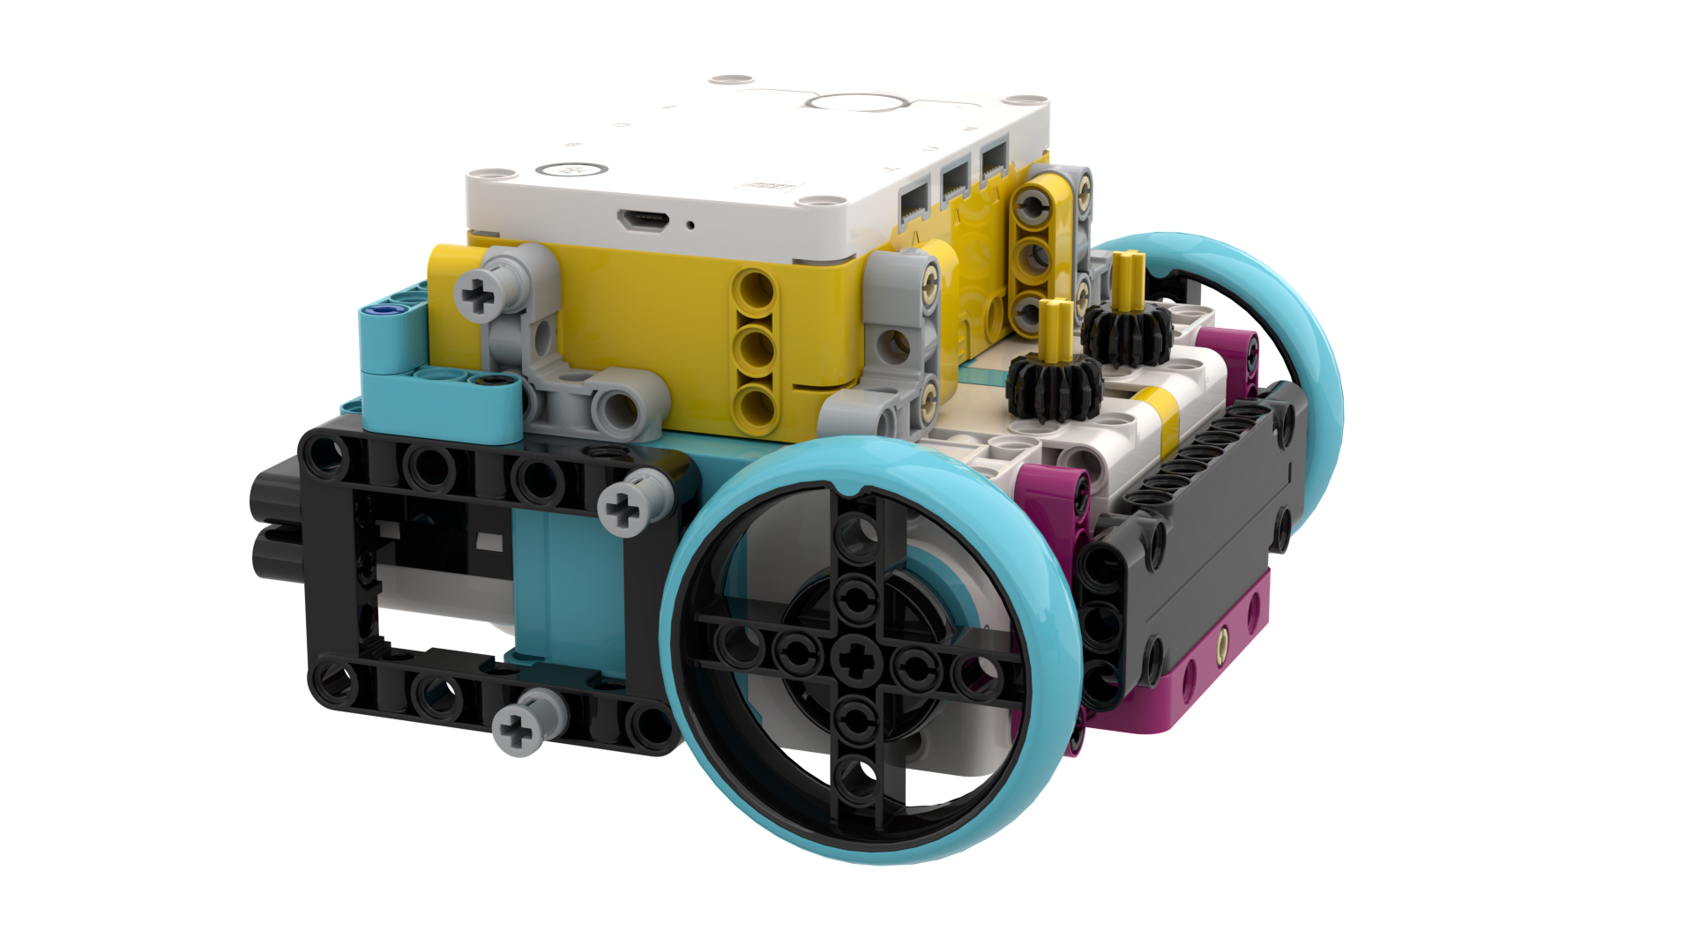
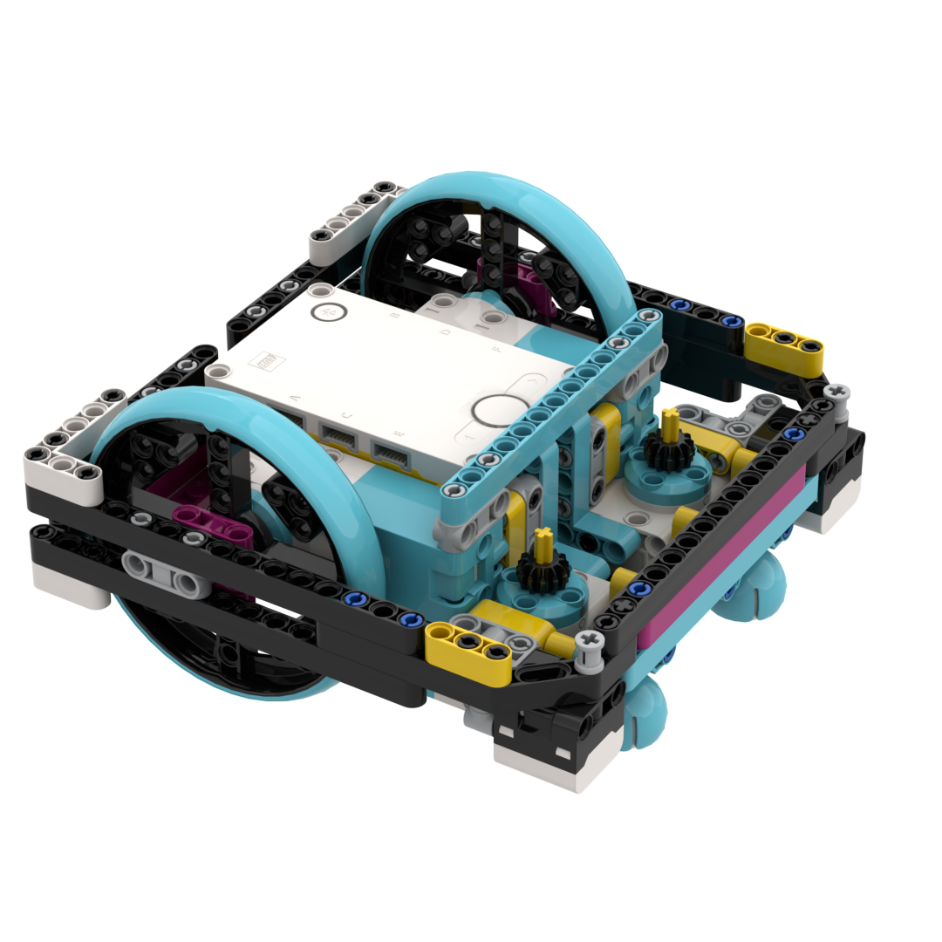
DESCRIBE THE SENSORS & MOTORS
How many motors and sensors do you use? Which ones? Why?
Which missions do you use them on?
How do you use sensors and do you use them in any novel way?

Slide 5
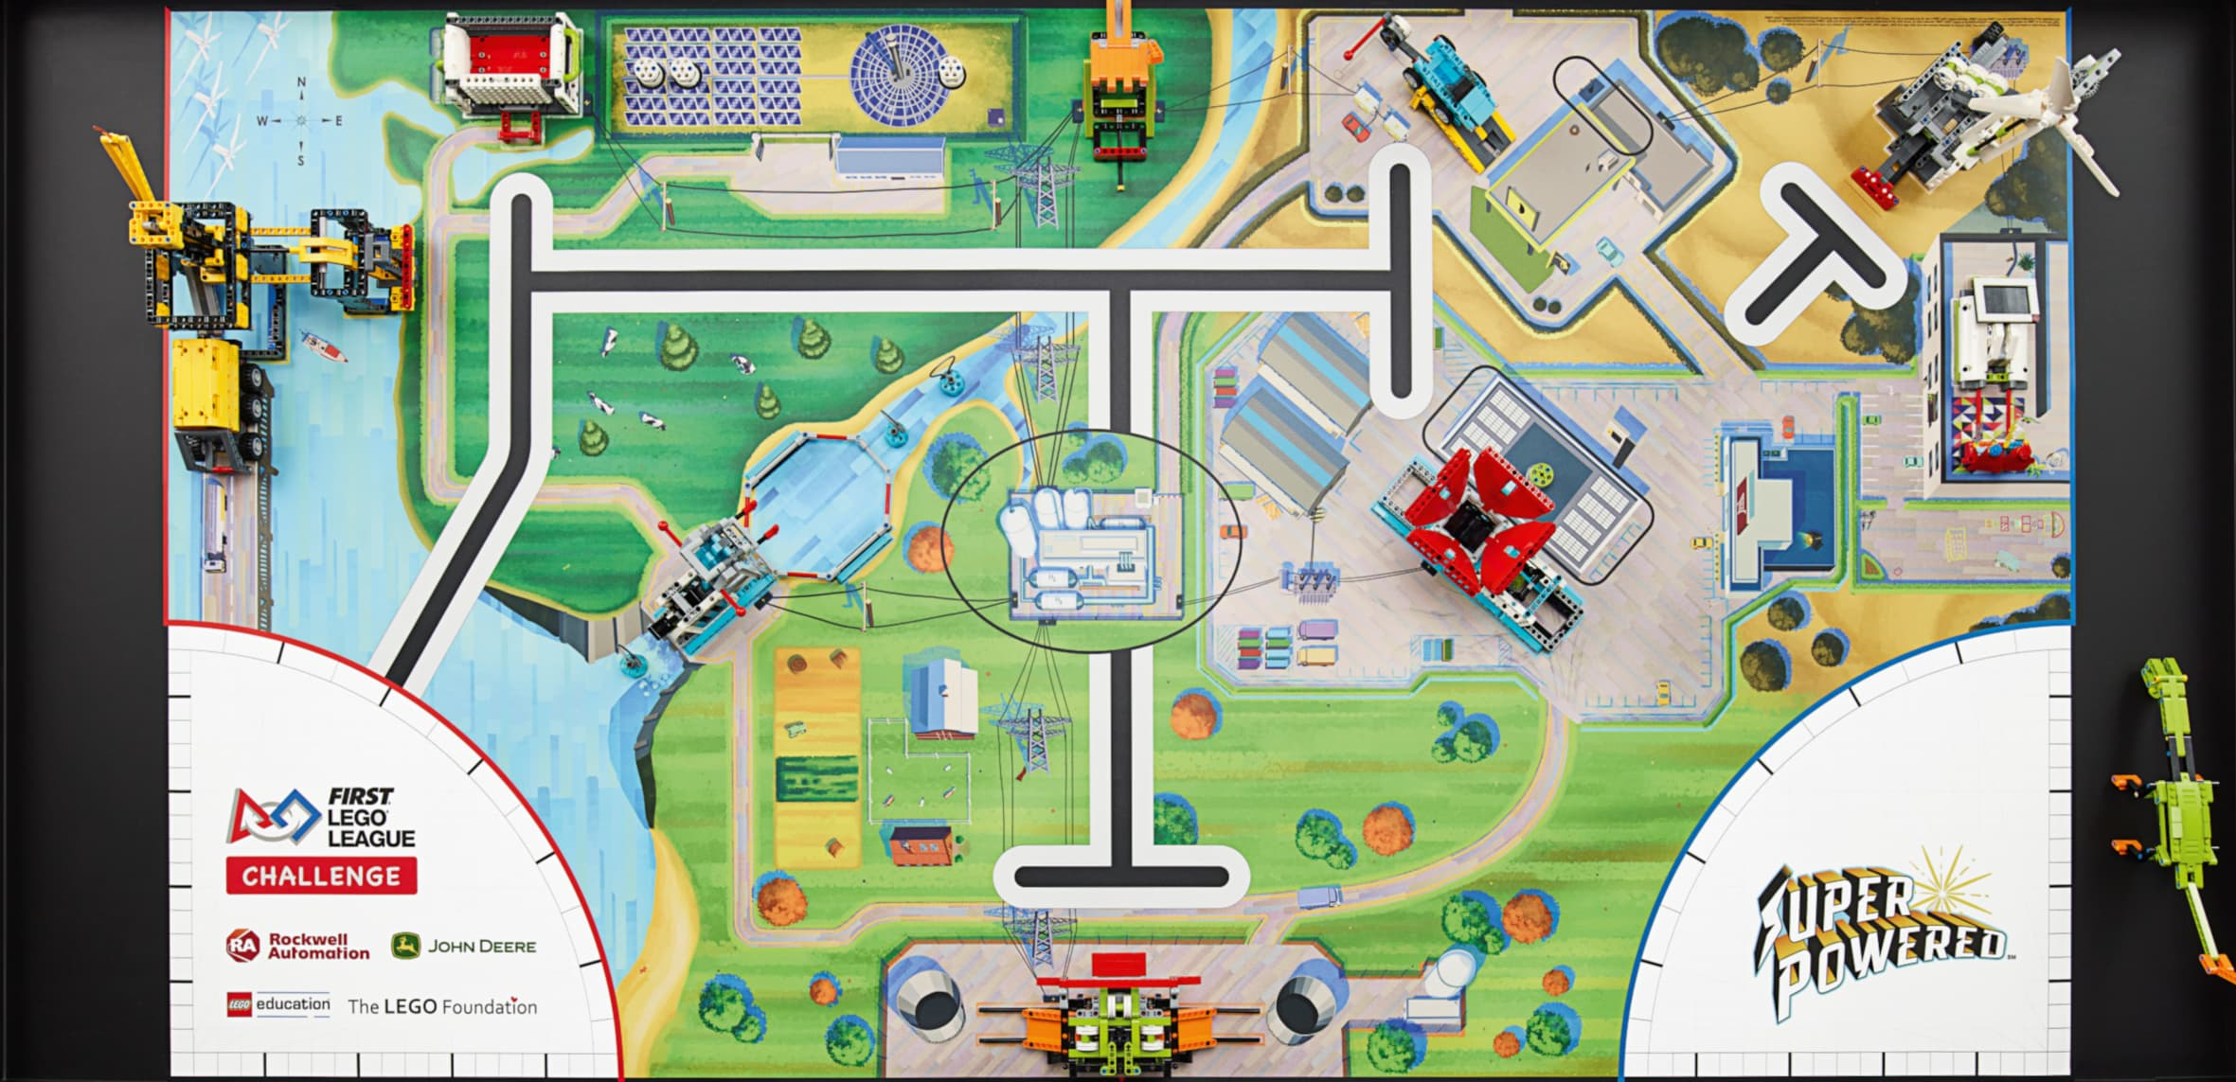
EXPLAIN YOUR TEAM’s STRATEGY
How did you come up with your strategy?
How did you decide on which missions to accomplish and which path to take?
3
Bring a picture like the one on right to explain your robot runs and strategy.
1
2

Slide 6
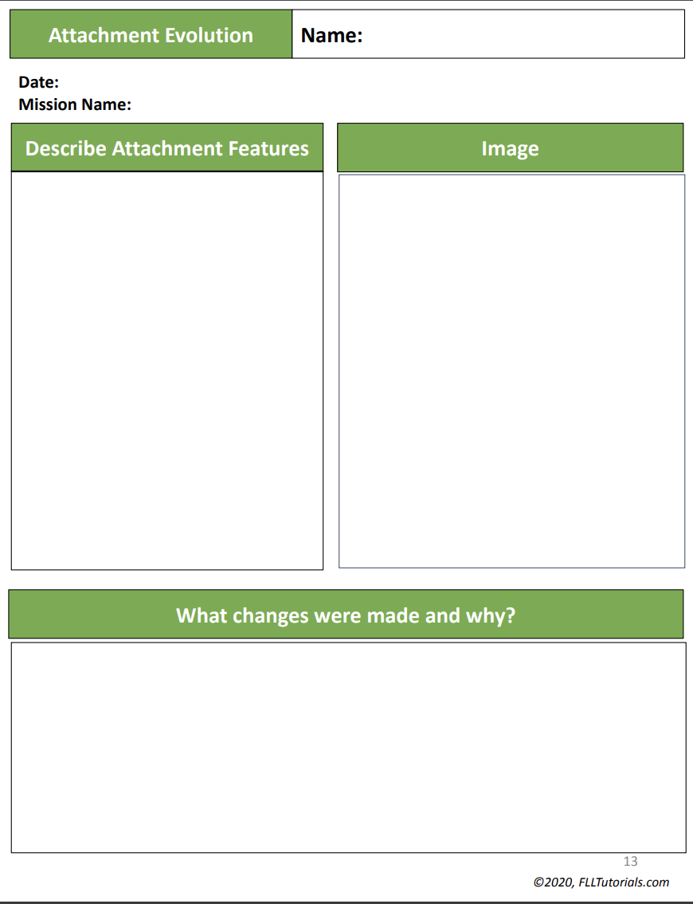
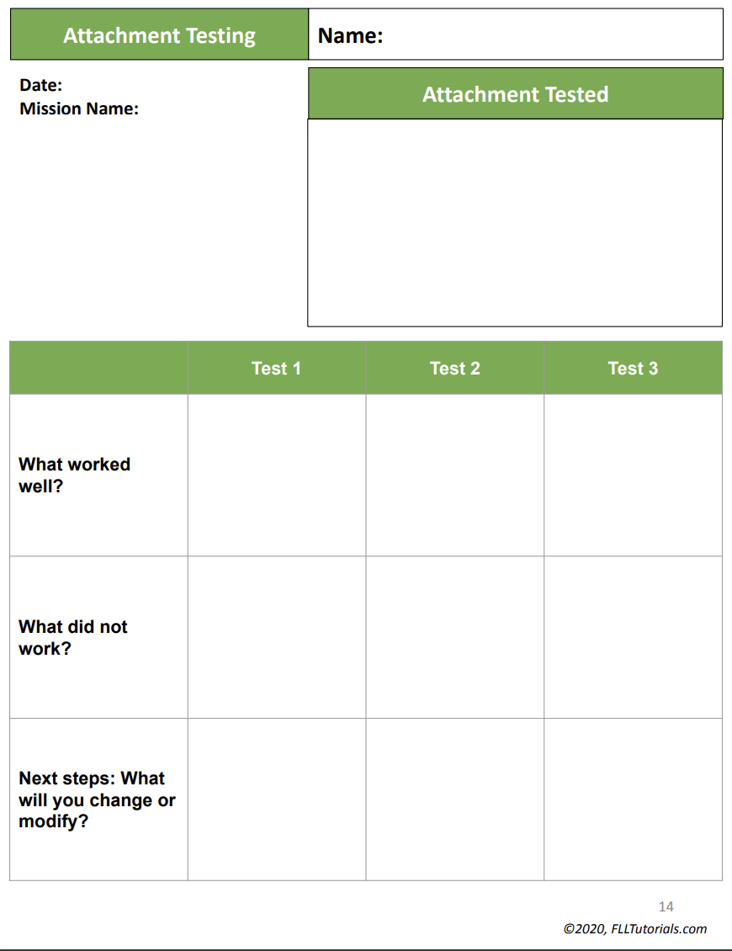
EXPLAIN your ATTACHMENT DEVELOPMENT
How do you solve the missions?
How did you come up with that particular solution?
How did that solution change over time?
Do you solve a particular mission in an unusual way?
Available at https://flltutorials.com/en/Worksheets.html

Slide 7
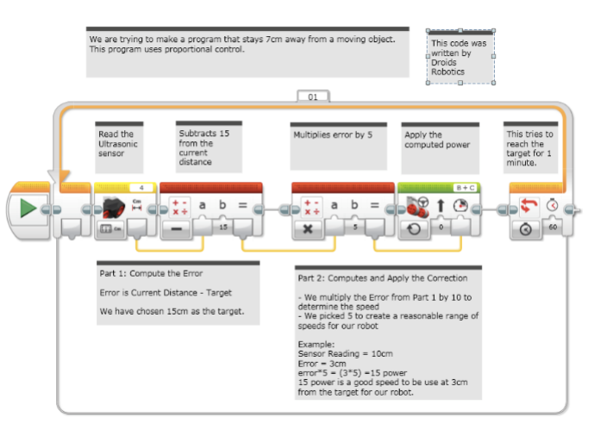
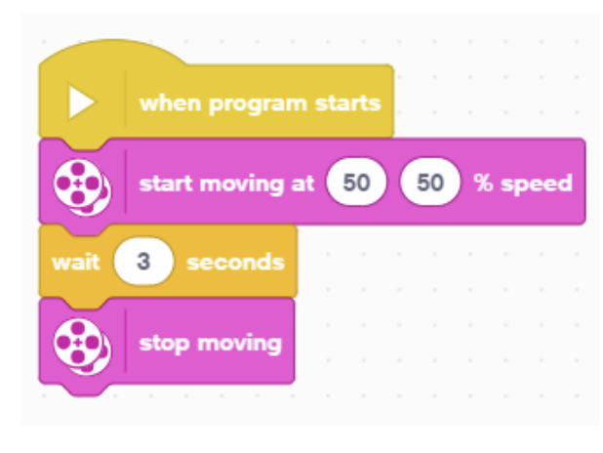
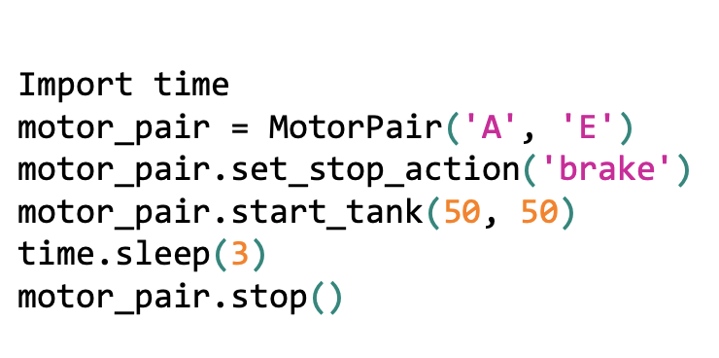
Explain your PROGRAMMING
You must explain your programming in judging.
You will not have time to talk about all your code. Pick one program, one run, or your best code.
No matter what programming language you used, you should be able to communicate your programming techniques to the judges
Make sure you have pseudocode and comments
You can share your code on a laptop or using a printout

Slide 8
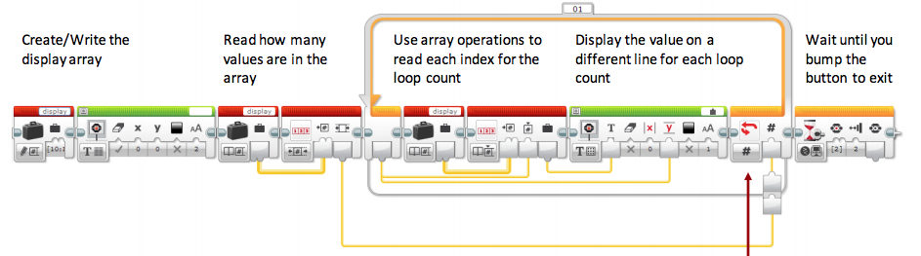
TIPS FOR Explaining YOUR PROGRAMMING
Explain how your code is organized
How do you know what a block is doing? Are there comments?
Do you use My Blocks (or equivalent Functions in another language)?
How do you keep track of changes to the code?
Explain any interesting algorithms your team came up with
Explain how your code helps your robot be more reliable. What coding techniques/sensors do you use?
Again, experienced judges will recognize code from others
If you used code from some source, always remember to cite it, explain how it works, and how your team modified or used it

Slide 9
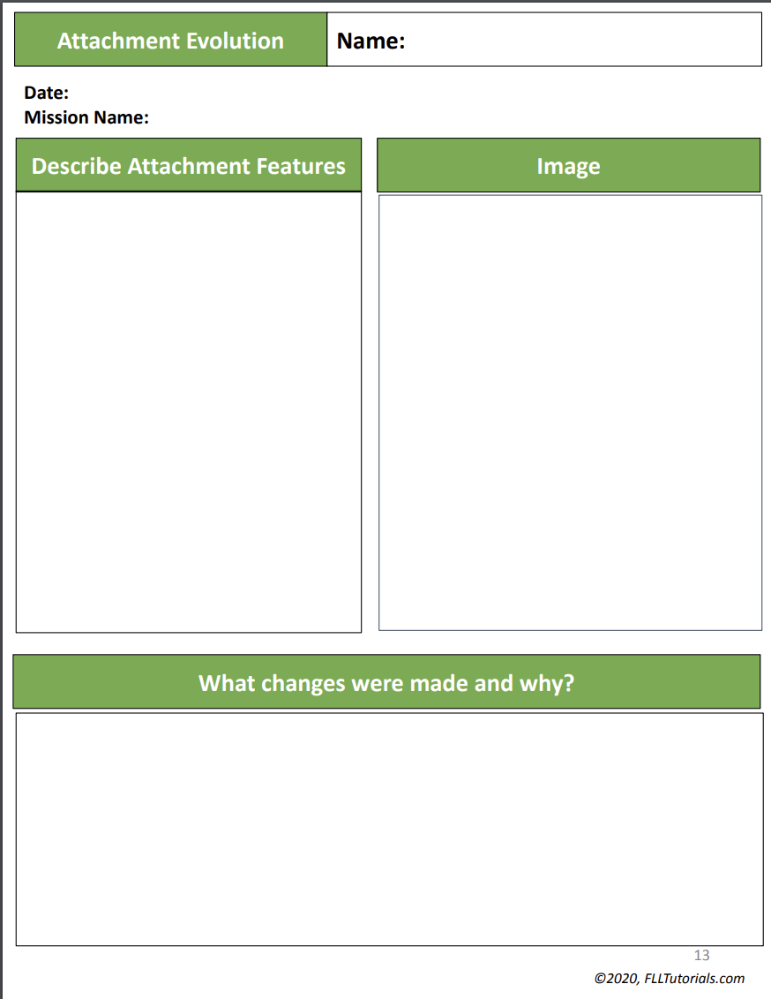
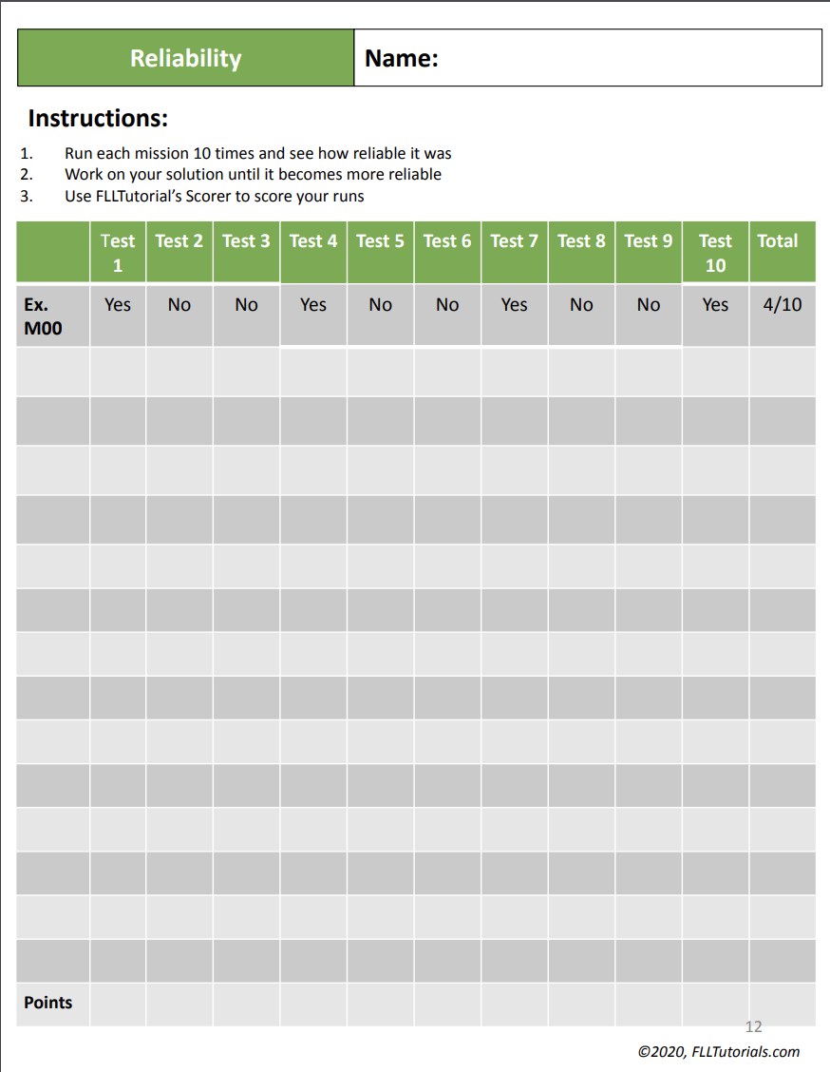
DOCUMENTATION
Consider having a team Engineering Journal to document your engineering design process
Share any testing your team may have done
Print out your code as well as pictures of your development process and current robot
If permitted, consider leaving a one-page summary of your presentation with your judges to help them remember your team (include a picture of your team, your robot and the key information you want to communicate)
Available at https://flltutorials.com/en/Worksheets.html

Slide 10
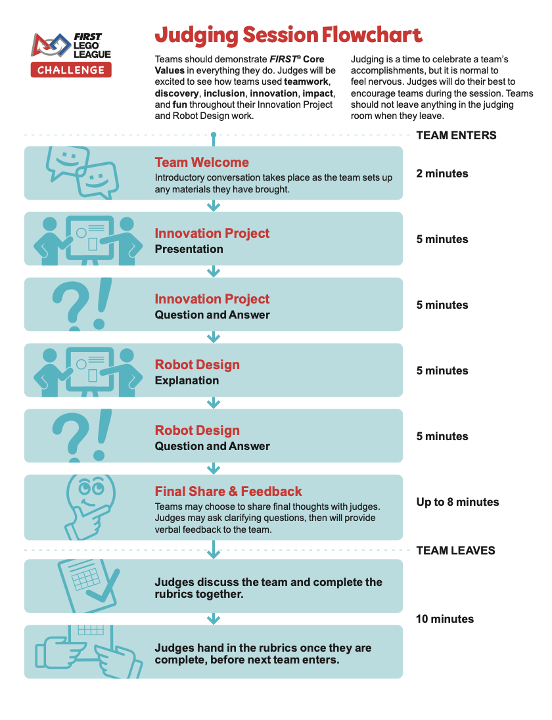
Final thoughts
Even though the Judging Flowchart refers to Robot Design as an “explanation” and not a presentation, you are strongly encouraged to prepare and practice a formal presentation
This way you ensure that everything you want to share about your robot design process is covered
Think of this session as a show-and-tell. You will show your robot, attachments and code and explain the process behind them
Again, cover everything in the rubric!

Slide 11
FAQs
What should we bring into the room?
Your robot, your attachment and all your code (either as printouts or on your laptop).
Evidence of testing and improvements made (photographs, charts, engineering notebook)
Do we have to explain code?
Yes. Teams who score higher are able to explain their code well and talk about its unique features.
What should we present in the 5 minutes?
Explain all aspects of the rubric (including how you designed the robot, selected a strategy, explain code, show that the entire team was involved, and show documentation of testing and improving your design)
Does everyone need to present?
Ideally, yes. The rubric asks if the entire team was involved in building in programming. Therefore, everyone should be able to contribute during the scripted presentation as well as during Q&A
There is no robot game table in the room so how can I show that my robot works?
Hold up your robot and attachment, come closer, and explain the mechanisms. Show testing data. Remember that Robot Design Judging is about PROCESS and not your robot game score. Explain your process well and you will score well in this category.

Slide 12
COMMON JUDGE QUESTIONS
How did you select which missions to do?
Was everyone on your team involved in building and programming?
How did you plan the season and organize the building and programming process?
What is the piece of code or part of the robot that you are proudest of and why?
What would you say is your most innovative design and/or code?
Does your robot use sensors to solve missions?
How did you ensure your robot would reliably score points on every launch?
Did you test different designs before picking this one?
What improvements did you make during the season?

Slide 13

Credits
This tutorial was created by Sanjay Seshan and Arvind Seshan
More lessons at www.ev3lessons.com, www.primelessons.org, and www.flltutorials.com
This work is licensed under a Creative Commons Attribution-NonCommercial-ShareAlike 4.0 International License.

